Slide 1

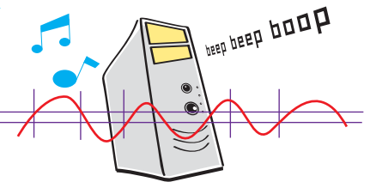
9. Media (sound effects, music, video)
Let’s Learn
Aj. Andrew Davison, CoE, PSU Hat Yai Campus
E-mail: ad@fivedots.coe.psu.ac.th

Slide 2
Outline
Sound Basics
Pygame Sound
Adding Sounds/Music to Pong
Playing Video

Slide 3
1. Sound Basics
Some common sound file types:
Wave files: e.g. hello.wav.
MP3 files: e.g. song.mp3.
WMA (Windows Media Audio) files: e.g. song.wma.
Ogg Vorbis files: e.g. song.ogg
Use Wave files for short sound effects
e.g. an explosion, thunder, "game over"
Use MP3 or Ogg for long music
e.g. the music played in the background during the game

Slide 4
Finding Sounds/Music Online
A great list: "55 Great Websites To Download Free Sound Effects"
http://www.hongkiat.com/blog/55-great-websites-to-download-free-sound-effects/
I often use findSounds:
http://www.findsounds.com/

Slide 5
Sound Editing
Sometimes you need to edit sound files:
cut out bits of the sound at the start/end
convert a sound into another format
Great, free tool: audacity
http://www.audacityteam.org/
can also record from a microphone

Slide 6
2. Pygame Sound
The Pygame mixer module deals with playing sounds/music
see http://www.pygame.org/docs/ref/mixer.html
It is loaded automatically when you call pygame.init()
Or you can type pygame.mixer.init()
add arguments to the call to change the default initialization settings

Slide 7
2.1. Playing a Sound Effect
splat = pygame.mixer.Sound("splat.wav")
splat.play()
this function returns straight away; it does not wait for the sound to finish playing
Set the volume:
splat.set_volume(0.5)
value can vary between 0 (off) to 1 (full)
call before play()

Slide 8
Some Code from Pong v.2
many sound effects can be loaded and played
restart = pygame.mixer.Sound("restart.wav")
restart.set_volume(0.5)
hitWall = pygame.mixer.Sound("hitWall.wav")
hitWall.set_volume(0.4)
restart.play()
hitWall.play()

Slide 9
2.2. Play Music
Only one piece of music
can play at a time
pygame.mixer.music.load("bg_music.mp3")
pygame.mixer.music.play() # plays once
play() returns without waiting for the music to finish
To play over and over:
pygame.mixer.music.play(-1)

Slide 10
MP3 Problem
Pygame cannot play all types of MP3 files.
If there is a problem, use Audacity to save the MP3 file as a new MP3 file.
Audacity's default settings work with Pygame
Or save the MP3 file as an OGG file

Slide 11
Stop music:
pygame.mixer.music.stop()
Controlling music volume:
pygame.mixer.music.set_volume(0.3)
value is between 0 and 1; call before play()

Slide 12
2.3. Detecting when Music Finishes
There are two approaches:
1. send a "user" event to the game loop when the music finishes
uses pygame.mixer.music.set_endevent()
2. call pygame.mixer.music.get_busy() to get a True/False answer

Slide 13
playMusic.py
import pygame
BLACK = (0, 0, 0)
WHITE = (255, 255, 255)
SONG_ENDED = pygame.constants.USEREVENT + 1
# a constant integer;
# must be bigger than the USEREVENT value
pygame.init()
screen = pygame.display.set_mode([200,100])
screen.fill(WHITE)
pygame.display.set_caption("Play Music")
pygame.mixer.music.load('ziggy.mp3')
# pygame.mixer.music.load('ziggy.ogg')
# pygame.mixer.music.load('smashingbaby.wav') # shorter song
pygame.mixer.music.set_endevent(SONG_ENDED)
music = pygame.mixer.music.play()

Slide 14
clock = pygame.time.Clock()
running = True
while running: # game loop
clock.tick(30)
for event in pygame.event.get():
if event.type == pygame.QUIT:
running = False
elif event.type == SONG_ENDED:
# This event is sent when the music finishes
print("music has finished")
running = False
screen.fill(WHITE)
pygame.display.update()
pygame.quit()

Slide 15
2.4. Other Pygame.mixer Features
Queue music to play
Fade a sound in or out
Fade a sound left-to-right
Pause a sound
Access the separate channels (usually 2) that make up the sound output

Slide 16
3. Adding Sounds/Music to Pong
See pong2.py
same as pong.py, but with an initMusic() function for loading 4 sound effects and 1 song as background music
sound effects for:
ball hits a paddle
ball hits a wall
score a point
game over

Slide 17
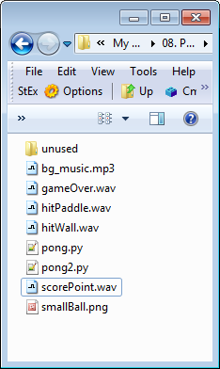
def initMusic():
global hitPaddle, hitWall, scorePoint, bye
# load background music; set volume
pygame.mixer.music.load("bg_music.mp3")
pygame.mixer.music.set_volume(0.3)
pygame.mixer.music.play(-1) # Play forever
# load sounds effects; set their volumes
hitPaddle = pygame.mixer.Sound("hitPaddle.wav")
hitPaddle.set_volume(0.4)
hitWall = pygame.mixer.Sound("hitWall.wav")
hitWall.set_volume(0.4)
scorePoint = pygame.mixer.Sound("scorePoint.wav")
scorePoint.set_volume(0.2)
bye = pygame.mixer.Sound("gameOver.wav")
bye.set_volume(0.6)

Slide 18
Playing the Sound Effects
Calls to play() for hitPaddle, hitWall, and scorePoint are added to the if-tests inside BallSprite.update()
e.g.
if pygame.sprite.spritecollideany(self,
horizWalls):
# change y-step direction at top
and bottom sides
hitWall.play()
self.yStep = -self.yStep

Slide 19
bye.play() is added when gameOver is set to true inside the game loop
e.g.
if scoreLeft >= WINNING_SCORE:
winMsg = "Left Wins!"
gameOver = True
bye.play()
elif scoreRight >= WINNING_SCORE:
winMsg = "Right Wins!"
gameOver = True
bye.play()

Slide 20
4. Playing Video
The pygame.movie module is used to play MPG (MPEG-1) and AVI videos
see http://www.pygame.org/docs/ref/movie.html
not all MPG / AVI formats are supported
Can play, pause, rewind, skip, set the volume, check if the movie is running (busy)
Not that useful for most games

Slide 21
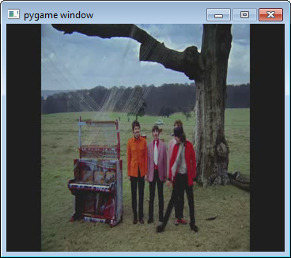
playMovie.py
import pygame
pygame.init()
pygame.mixer.quit() # so video sound can be heard
movie = pygame.movie.Movie('sff.mpg')
# movie = pygame.movie.Movie('sff.avi')
screen = pygame.display.set_mode(movie.get_size())
movie_screen = pygame.Surface(movie.get_size()).convert()
movie.set_display(movie_screen)
movie.play()

Slide 22
clock = pygame.time.Clock()
running = True
while running:
clock.tick(60) # faster than usual
for event in pygame.event.get():
if event.type == pygame.QUIT:
movie.stop()
running = False
if not movie.get_busy(): # not busy == finished
movie.stop() # close down movie player
running = False
screen.blit(movie_screen,(0,0)) # display
pygame.display.update()
pygame.quit()

Slide 23
Finding Movie Clips
YouTube videos + downloader
e.g. ClipConverter (http://www.clipconverter.cc/)
Pygame recommends that you use ffmpeg (http://ffmpeg.org/) to convert a video file to the correct type of MPG file format
MPEG-1 video, MPEG-1 Audio Layer III (MP3) sound

Slide 24
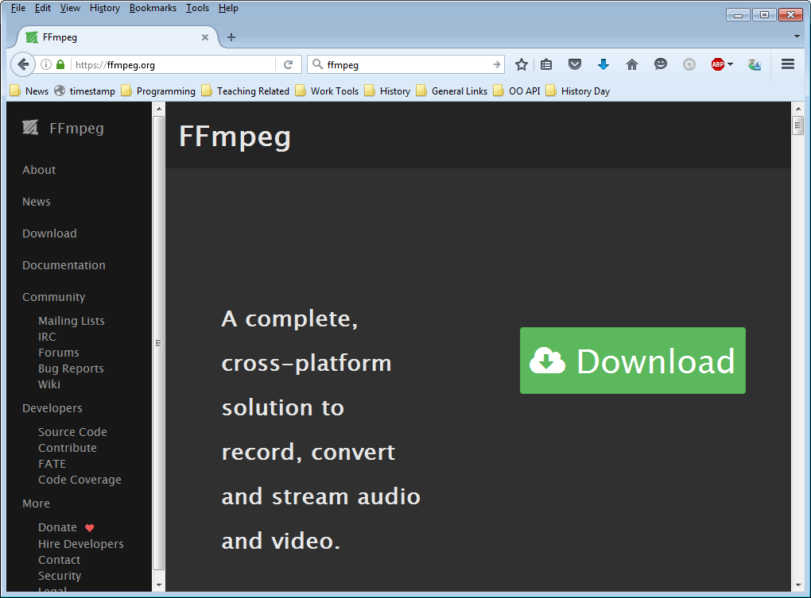

Slide 25
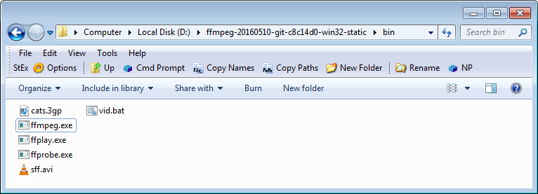
Using ffmpeg
My vid.bat file supplies the right arguments to ffmpeg.exe
put in the ffmpeg bin/ directory
call from the command prompt in the bin/ directory
vid.bat cats.3pg # creates cats.mpg
vid.bat sff.avi # creates sff.mpg

